Slide 1

Feature prediction of heart attacks identification with machine learning

Slide 2
TEAM MEMBERS:
Sai Susmitha Devi Komatlapalli -700742098
Bhavana Prathyusha Madhugani - 700737914
Bhuvana Nandhimalla - 700744203

Slide 3
Contents:
Roles and Responsibilities
Motivation
Objectives
Related work
Problem statement
Proposed solution
Result/Simulation references

Slide 4
ROLES AND RESPONSIBILITIES:
Prathyusha - Worked on identifying the necessary papers , data selection and basic coding for the project implementation.
Sushmitha - Worked on dataset collection based on the column names required for the project , and tested different values with coding.
Bhuvana - Worked on coding for implementing the dataset by importing and testing values along with documentation.

Slide 5
MOTIVATION :
Heart disease is one of the most well-known causes of death worldwide.
Patients are typically asymptomatic until a fatal occurrence occurs, and in any case, a trained personnel is required to spot a heart abnormality while they are being observed.
Electrocardiograms (ECG) can be used in computer-aided design, therefore there is growing evidence that machine learning can be used to identify these irregularities.
We can now use this knowledge to build models that are ready to evaluate heartbeat instances and spot anomalies in them thanks to recent advancements..

Slide 6
OBJECTIVE :
The objective of heart attack identification with machine learning is to detect the heart disease in the early stage itslef with the available attributes.
In this work , the dataset containing the heart attack will be taken into consideration. The pre-processing will be applied in to the dataset and the noisy and null value data will be removed from the dataset. After the data will be analyzed and visualized for further processing.

Slide 7

RELATIVE WORK :
Different researches have undergone for the prediction of diseases using machine learning techniques .
An Imbalanced-Data Processing Algorithm for the Prediction of Heart Attack in Stroke Patients was proposed by Meng Wang is the strategy to lower a high death rate is to early anticipate heart attacks in stroke patients using data analysis. Because heart attack patients make up a smaller percentage of stroke patients, the data on stroke patients in intensive care units is unbalanced. It becomes difficult to forecast heart attacks using stroke patient data.
This study develops an algorithm for processing the unbalanced data by Undersampling , clustering, oversampling algorithm, or UCO algorithm for short.
The UCO technique produces almost balanced data that is used to train machine learning models for heart attack prediction.

Slide 8
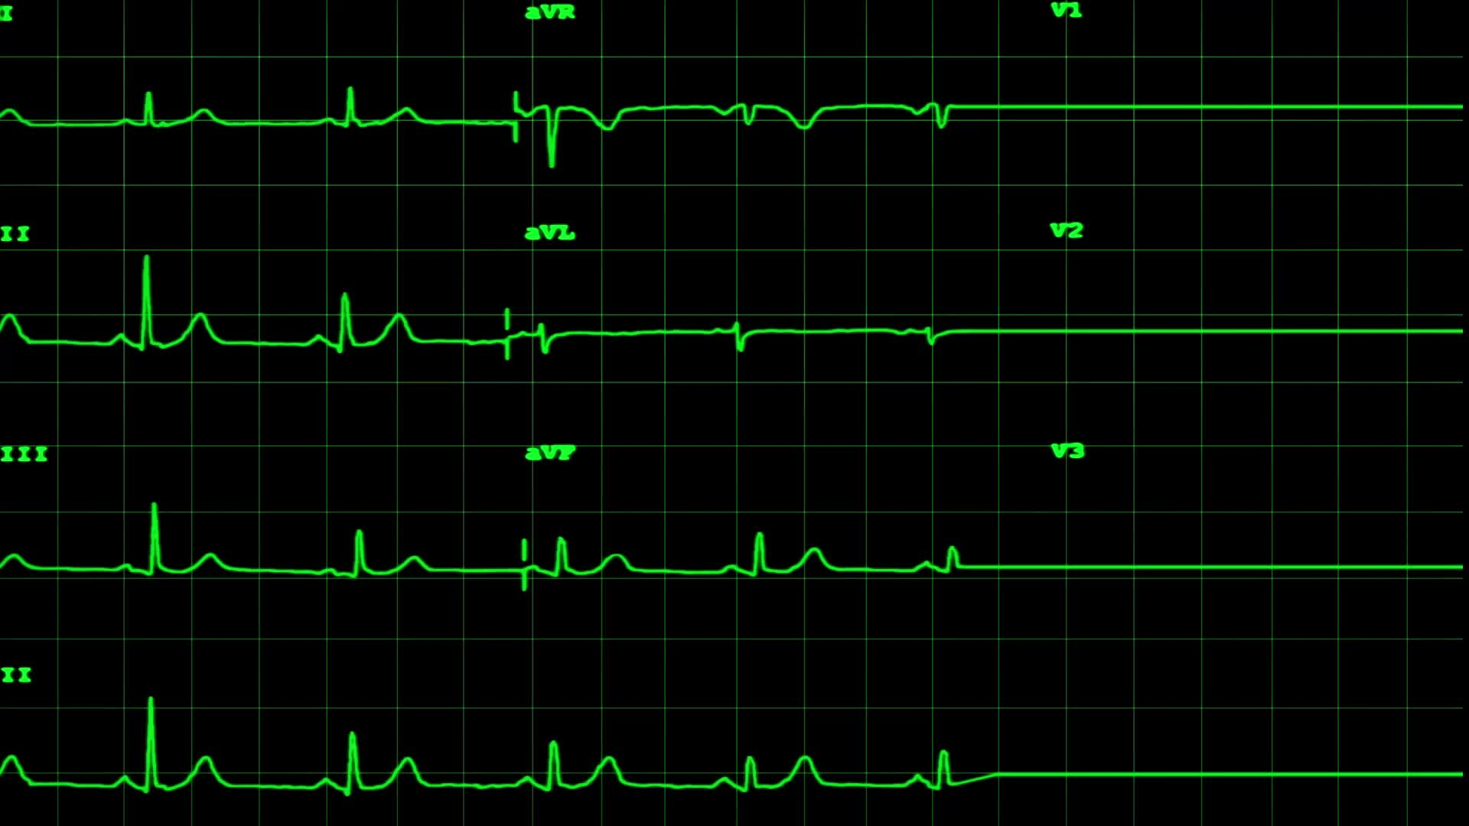
PROBLEM STATEMENT :
To forecast and track the progression of complex ongoing disorders, such declining cardiovascular health. limited apparent evidence supporting the high likelihood of confusing persistent illnesses like Heart Failure.
Additionally, the present approaches have shown modest performance in incredibly complex cardiac datasets for risk anticipation in diverse circumstances, including heart failure.
Demonstrating outcomes in a language that people can comprehend. Due to this, they are now less trustworthy and are less prepared to take a chance with important assertions and more extensive clinical evaluation.

Slide 9
PROPOSED SOLUTIONS :
Using the provided features, cardiovascular disease detection using machine learning intends to detect heart disease at an early stage. This project will make use of the dataset that contains information on cardiovascular diseases.
The dataset will go through some basic processing, and any noisy or null-valued data will be removed. Further computing will follow data visualization and analysis.
A machine intelligence algorithm will be utilized to make the forecast. The information set will be divided into two parts. The deep learning system is trained using 70% of the initial dataset's data, with the remaining 30% used for testing.

Slide 10
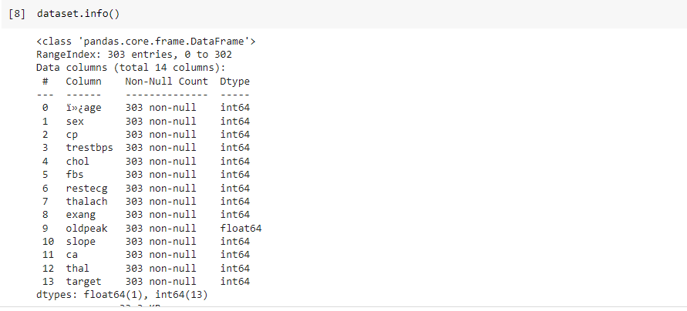
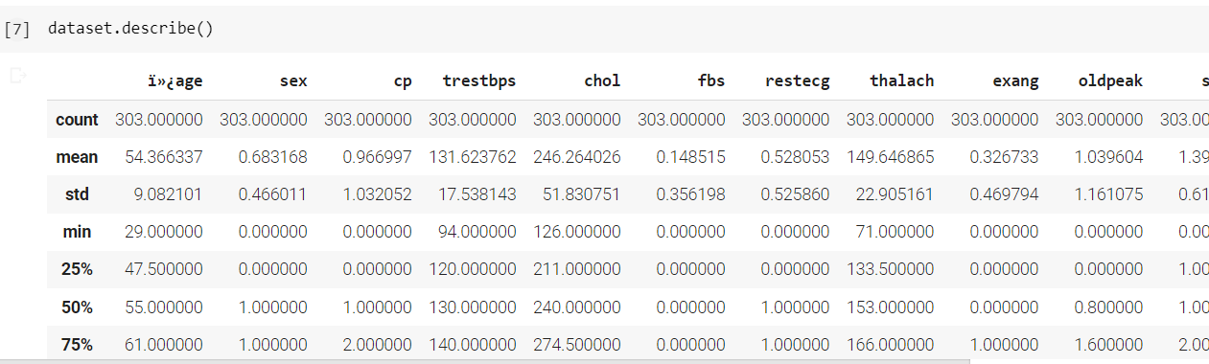
RESULTS :
Few records from data set
Statistical reports for the columns

Slide 11
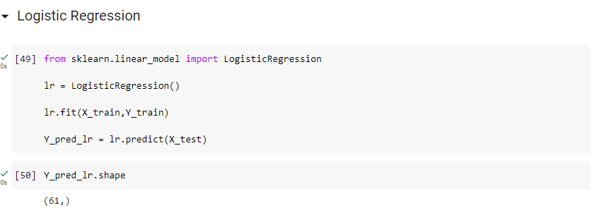
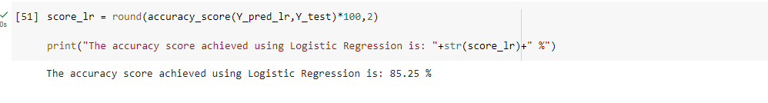
Evaluation with Logistic Regression Algorithm:

Slide 12
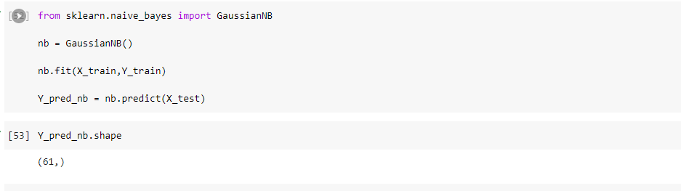
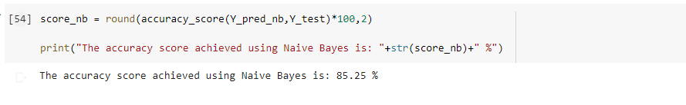
Evaluation with Naive Bayes:

Slide 13
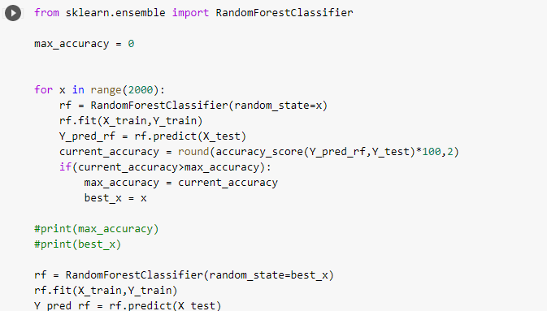
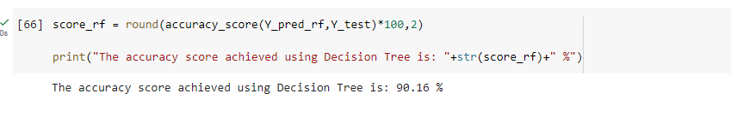
Evaluation with Random Forest Algorithm:

Slide 14
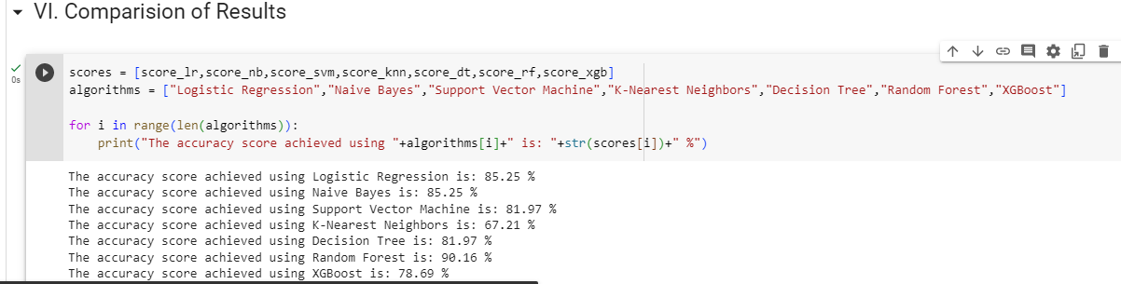
Comparison result:

Slide 15
REFERENCES
Eun s. lee 1, (member, ieee), byeong g. choi 2, (member, ieee), myung y. kim1, (Member, IEEE), AND SEUNG H. HAN 3, (Member, IEEE)” An Imbalanced-DataProcessingAlgorithmforthe Prediction of Heart Attack in Stroke Patients”. January 14, 2021, date of publication February 8, 2021, date of current version February 16, 2021, IEEE.
Samiul based shuvo 1, shams nafisa ali 1, (student member, ieee), soham irtiza swapnil1, mabrook s. al-rakhami 2, (senior member, ieee), and abdu gumaei “CardioXNet: A Novel Lightweight Deep Learning Framework for Cardiovascular Disease Classification Using Heart Sound Recordings”. February 24, 2021, date of publication March 2, 2021, date of current version March 9, 2021.IEEE.
G. Liang and L. Zheng, “A transfer learning method with deep residual network for pediatric pneumonia diagnosis,” Computer methods and programs in biomedicine, vol. 187, p. 104964, 2020

Slide 16
THANK YOU

